Slide 1
Lecture 12
Advanced Sorting Algorithms
Ashenafi Chalchissa
Email:achalchissaguta@gmail.com
December 2017

Slide 2
Revision - Sorting
Sorting is a technique to rearrange the elements of a list in ascending or descending order.
A sorting algorithm is an algorithm that puts elements of a list in a certain order.
The most-used orders are numerical order and lexicographical order.
Sorting Example:
Given: a set (container) of n elements
  E.g. array, set of words, etc.
Suppose: there is an order relation that can be set across the elements
Goal: Arrange the elements in ascending order
  Start → 1 23 2 56 9 8 10 100
  End → 1 2 8 9 10 23 56 100

Slide 3
Sorting Algorithms
The sorting algorithms can be categorized as:
  Insertion sort
  Bubble sort
  Selection sort
  Shell sort
  Quick sort
  Heap sort
  Merge sort
  Radix sort
Simple Sorting Algorithms
Advanced (Efficient) Sorting Algorithms
Notes:
M. Hammad Waseem
Sorting Algorithms

Slide 4
Shell Sort
The shell sort, also known as the diminishing increment sort, was developed by Donald L. Shell in 1959.
The idea behind shell sort is that it is faster to sort an array if parts of it are already sorted.
The original array is first divided into a number of smaller subarrays, these subarrays are sorted, and then they are combined into the overall array and sorted.

Slide 5
How Shell Sort Works?
One approach would be to divide the array into a number of sub arrays consisting of contiguous elements (i.e. elements that are next to each other).
For example, the array [abcdef] could be divided into the sub arrays [abc] and [def].
However, shell sort uses a different approach: the sub arrays are constructed by taking elements that are regularly spaced from each other.
For example, a sub array may consist of every second element in an array, or every third element, etc.
For example, dividing the array [abcdef] into two sub arrays by taking every second element results in the sub arrays [ace] and [bdf]

Slide 6
Cont’d
Actually, shell sort uses several iterations of this technique.
First, a large number of sub arrays, consisting of widely spaced elements, are sorted.
Then, these sub arrays are combined into the overall array, a new division is made into a smaller number of sub arrays and these are sorted.
In the next iteration a still smaller number of sub arrays is sorted.
This process continues until eventually only one sub array is sorted, the original array itself.

Slide 7
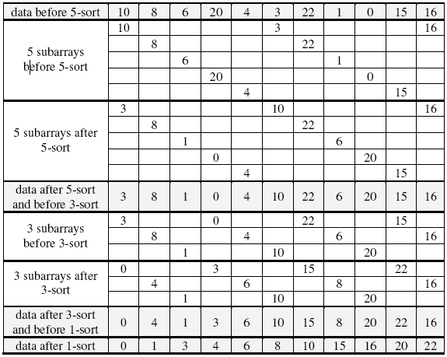

Slide 8
Cont’d
In the above example, we used three iterations: a 5-sort, a 3-sort and a 1-sort.
This sequence is known as the diminishing increment.
But how do we decide on this sequence of increments?
  Powers of 2 were used for the increments,
  e.g. 16, 8, 4, 2, 1.
However, this is not the most efficient technique.
Experimental studies have shown that increments calculated according to the following conditions lead to better efficiency:
h₁ = 1
h_{i+1} = 3h_{i} + 1
For example, for a list of length 100 the sequence of increments would be 40, 13, 4, 1.

Slide 9
Cont’d
An experimental analysis has shown that the complexity of shell sort is approximately O(n^{1.25}),
  which is better than the O(n²) offered by the simple algorithms.
But it is advisable to choose g_{k} =n/2 and g_{k-1} = g_{i}/2 for k>=i>=1. After each sequence g_{k-1} is done and the list is said to be g_{i}-sorted.
Shell sorting is done when the list is 1-sorted (which is sorted using insertion sort) and A[j]<=A[j+1] for 0<=j<=n-2. Time complexity is O(n^{3/2}).

Slide 10
Cont’d
Example: Sort the following list using shell sort algorithm.
  5 8 2 4 1 3 9 7 6 0
Choose g₃ =5 (n/2 where n is the number of elements =10)
Sort (5, 3)
  3 8 2 4 1 5 9 7 6 0
Sort (8, 9)
  3 8 2 4 1 5 9 7 6 0
Sort (2, 7)
  3 8 2 4 1 5 9 7 6 0
Sort (4, 6)
  3 8 2 4 1 5 9 7 6 0

Slide 11
Cont’d
Sort (1, 0)
  3 8 2 4 0 5 9 7 6 1
5- sorted list
  3 8 2 4 0 5 9 7 6 1
Sort (3, 4, 9, 1)
  1 8 2 3 0 5 4 7 6 9
Sort (8, 0, 7)
  1 0 2 3 7 5 4 8 6 9
Sort (2, 5, 6)
  1 0 2 3 7 5 4 8 6 9
3- sorted list
  1 0 2 3 7 5 4 8 6 9

Slide 12
Cont’d
Choose g1 =1 (the same as insertion sort algorithm)
Sort (1, 0, 2, 3, 7, 5, 4, 8, 6, 9)
  0 1 2 3 4 5 6 7 8 9
1- sorted (shell sorted) list
  0 1 2 3 4 5 6 7 8 9

Slide 13
Quick Sort
Quick sort is the fastest known algorithm.
It uses divide and conquer strategy and in the worst case its complexity is O (n²).
But its expected complexity is O(nlogn).
Algorithm:
  Choose a pivot value (mostly the first element is taken as the pivot value)
  Position the pivot element and partition the list so that:
    the left part has items less than or equal to the pivot value
    the right part has items greater than or equal to the pivot value
  Recursively sort the left part
  Recursively sort the right part

Slide 14
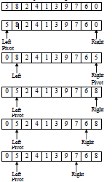
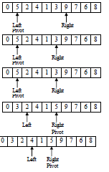
Example

Slide 15
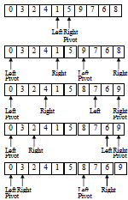
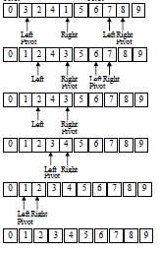
Cont’d

Slide 16
Implementation
Left=0;
Right=n-1; // n is the total number of elements in the list
PivotPos=Left;
while(Left<Right)
{
if(PivotPos==Left)
{
if(Data[Left]>Data[Right])
{
swap(data[Left], Data[Right]);
PivotPos=Right;
Left++;
}
else
Right--;
}

Slide 17
Cont’d
else
{
if(Data[Left]>Data[Right])
{
swap(data[Left], Data[Right]);
PivotPos=Left;
Right--;
}
else
Left++;
}
}

Slide 18
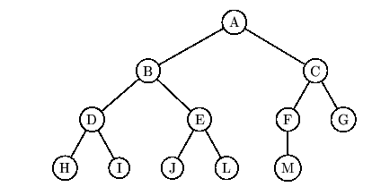
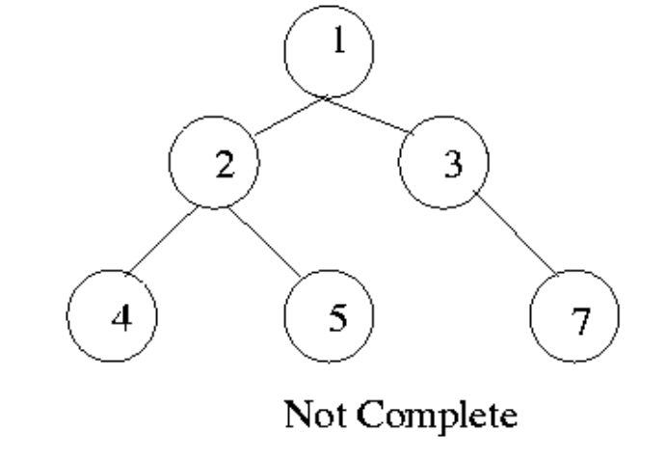
Heap Sort
A heap is a complete binary tree with the property that the value at each node is at least as large as the values at its children.
A largest element is at the root of the heap.
Complete binary tree is a binary tree in which the level of the any leaf node is either H or H-1 where H is the height of the tree. The deepest level should also be filled from left to right.

Slide 19
Cont’d
The relation greater than or equal to may be reversed so that the parent node contains a value as small as or smaller than its children.
Max Heap
  Store data in ascending order
  Has property of
  A[Parent(i)] ≥ A[i]
Min Heap
  Store data in descending order
  Has property of
  A[Parent(i)] ≤ A[i]

Slide 20
Max Heap Example
19
12
16
1
4
7
19
12
16
1
4
7
Array A

Slide 21
Min Heap Example
1
4
16
7
12
19
1
4
16
7
12
19
Array A

Slide 22
Transform an Array Into a Heap: Example
6
3
5
7
2
4
10
9
rebuildHeap()
0
1
2
3
4
5
6
7
The items in the array, above, can be considered to be stored in the complete binary tree shown at right.
rebuildHeap() is invoked on the parent of the last node in the array (= 9).
6
3
5
7
2
4
10
9

Slide 23
Cont’d
6
3
5
9
2
4
10
7
0
1
2
3
4
5
6
7
rebuildHeap()
rebuildHeap() is invoked on the node in the array preceding node 9.
6
3
5
9
2
4
10
7

Slide 24
Cont’d
6
3
10
9
2
4
5
7
rebuildHeap()
0
1
2
3
4
5
6
7
6
rebuildHeap() is invoked on the node in the array preceding node 10.
3
10
9
2
4
5
7

Slide 25
Cont’d
6
9
10
3
2
4
5
7
rebuildHeap()
0
1
2
3
4
5
6
7
6
rebuildHeap() is invoked recursively on node 3 to complete the transformation of the semiheap rooted at 9 into a heap.
9
10
3
2
4
5
7

Slide 26
Cont’d
6
9
10
7
2
4
5
3
rebuildHeap()
0
1
2
3
4
5
6
7
6
The recursive call to rebuildHeap() returns to node 9.
rebuildHeap() is invoked on the node in the array preceding node 9.
9
10
7
2
4
5
3

Slide 27
Cont’d
10
9
6
7
2
4
5
3
0
1
2
3
4
5
6
7
10
Note that node 10 is now the root of a heap.
The transformation of the array into a heap is complete.
9
6
7
2
4
5
3

Slide 28
Exercise
Form a heap from the set 40,80,35,90,45,50,70.

Slide 29
Heap Sort …
A sorting algorithm that works by first organizing the data to be sorted into a special type of binary tree called a heap.
Procedures on Heap:
  Heapify
  Build Heap
  Heap Sort

Slide 30
Heapify
Heapify picks the largest child key and compare it to the parent key.
If parent key is larger then heapify quits, otherwise it swaps the parent key with the largest child key.
So that the parent is now becomes larger than its children.
Heapify(A, i)
{ l ← left(i)
r ← right(i)
if l <= heapsize[A] and A[l] > A[i]
then largest ←l
else largest ← i
if r <= heapsize[A] and A[r] > A[largest]
then largest ← r
if largest != i
then swap A[i] ←→ A[largest]
Heapify(A, largest)
}

Slide 31
Build Heap
We can use the procedure 'Heapify' in a bottom-up fashion to convert an array A[1 . . n] into a heap.
Since the elements in the subarray A[n/2 +1 . . n] are all leaves, the procedure BUILD_HEAP goes through the remaining nodes of the tree and runs 'Heapify' on each one.
The bottom-up order of processing node guarantees that the subtree rooted at children are heap before 'Heapify' is run at their parent.
Buildheap(A)
{
heapsize[A] ←length[A]
for i ←|length[A]/2 //down to 1
do Heapify(A, i)
}

Slide 32
Heap Sort Algorithm
The heap sort algorithm starts by using procedure BUILD-HEAP to build a heap on the input array A[1 . . n].
Since the maximum element of the array stored at the root A[1], it can be put into its correct final position by exchanging it with A[n] (the last element in A).
If we now discard node n from the heap then the remaining elements can be made into heap.
Note that the new element at the root may violate the heap property. All that is needed to restore the heap property.
Heapsort(A)
{ Buildheap(A)
for i ← length[A] //down to 2
do swap A[1] ←→ A[i]
heapsize[A] ← heapsize[A] - 1
Heapify(A, 1)
}

Slide 33
Cont’d
Example: Convert the following array to a heap
16
4
7
1
12
19
Picture the array as a complete binary tree:
16
4
7
1
12
19

Slide 34
16
16
4
7
4
19
swap
12
19
1
12
7
1
16
19
swap
12
19
12
16
swap
4
7
1
4
7
1

Slide 35
Cont’d
The heapsort algorithm consists of two phases:
  build a heap from an arbitrary array
  use the heap to sort the data
To sort the elements in the decreasing order, use a min heap
To sort the elements in the increasing order, use a max heap
19
12
16
1
4
7

Slide 36
Cont’d
Take out biggest
19
12
16
Move the last element
to the root
1
4
7
Sorted:
Array A
12
16
1
4
7
19

Slide 37
7
swap
HEAPIFY()
12
16
1
4
Sorted:
Array A
7
12
16
1
4
19

Slide 38
16
12
7
1
4
Sorted:
Array A
16
12
7
1
4
19

Slide 39
Take out biggest
16
Move the last element
to the root
12
7
1
4
Sorted:
Array A
12
7
1
4
16
19

Slide 40
4
12
7
1
Sorted:
Array A
4
12
7
1
16
19

Slide 41
swap
4
HEAPIFY()
12
7
1
Sorted:
Array A
4
12
7
1
16
19

Slide 42
12
4
7
1
Sorted:
Array A
12
4
7
1
16
19

Slide 43
Take out biggest
12
Move the last
element to the
root
4
7
1
Sorted:
Array A
4
7
1
12
16
19

Slide 44
1
swap
4
7
Sorted:
Array A
1
4
7
12
16
19

Slide 45
7
4
1
Sorted:
Array A
7
4
1
12
16
19

Slide 46
Take out biggest
7
Move the last
element to the
root
4
1
Sorted:
Array A
1
4
7
12
16
19

Slide 47
swap
1
HEAPIFY()
4
Sorted:
Array A
4
1
7
12
16
19

Slide 48
Take out biggest
Move the last
element to the
root
4
1
Sorted:
Array A
1
4
7
12
16
19

Slide 49
Take out biggest
1
Sorted:
Array A
1
4
7
12
16
19

Slide 50
Time Analysis
Build Heap Algorithm will run in O(n) time.
There are n-1 calls to Heapify each call requires O(logn) time.
Heap sort program combine Build Heap program and Heapify, therefore it has the running time of O(nlogn) time.
Total time complexity: O(nlogn).
Reference for Visualization:
  https://www.cs.usfca.edu/~galles/visualization/Algorithms.html

Slide 51
Reading Assignment
Merge Sort and
Radix Sort

